Slide 1

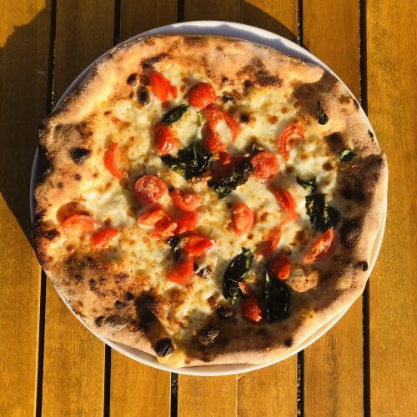
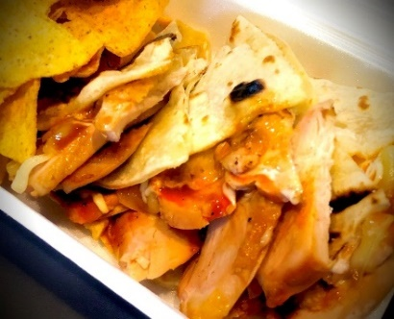
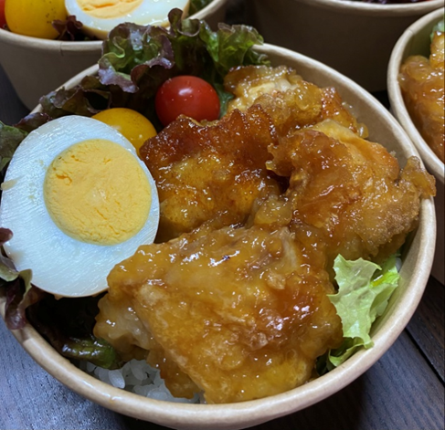
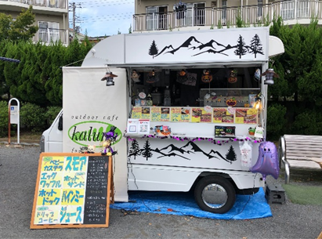
Food Truck Schedule FEB 2024
SUN | MON | TUE | WED | THU | FRI | SAT
 |  |  |  | 1 〇 | 2 〇 | 3
4 | 5 △ | 6 〇 | 7 〇 | 8 〇 | 9 〇 | 10
11 | 12 △ | 13 〇 | 14 〇 | 15 〇 | 16 〇 | 17
18 | 19 △ | 20 〇 | 21 〇 | 22 〇 | 23 〇 | 24
25 | 26 △ | 27 〇 | 28 〇 | 29 〇
〇 | Kaluna
△ | DADDY’S PIZZA
Garlic Butter Rice
Japanese food
/Korean food
Pizza
Quesadilla
□
BENTO SHOP ON THE HILL
 | DADDY’S PIZZA
 | Kaluna
BENTO SHOP ON THE HILL

